Slide 1
Project Procurement Management

Slide 2
Learning Objectives
Describe term outsourcing and the importance of project procurement management for IT projects
Identify the processes in procurement management
Define the term e-procurement

Slide 3
Project Procurement Management
Procurement means acquiring goods and/or services from an outside source.
Project Procurement Management includes the processes required to Acquiring goods and services for a project from outside the performing organization.

Slide 4
Project Procurement Management Processes
Processes include:
– Planning purchases and acquisitions: determining what to procure, when, and how.
– Planning contracting: Describing requirements for
the products or services desired from the procurement and identifying potential sources or sellers (contractors, suppliers, or providers who provide goods and services to other organizations).

Slide 5
Project Procurement Management Processes
Requesting seller responses: Obtaining information, quotes, bids, offers, or proposals from sellers, as appropriate.
Selecting sellers: Choosing from among potential suppliers through a process of evaluating potential sellers and negotiating the contract.
Administering the contract: Managing the relationship with the selected seller.
Closing the contract: Completing and settling each contract, including resolving any open items.

Slide 6
Why Outsource?
To reduce both fixed and recurrent costs
To allow the client organization to focus on its core business
To access skills and technologies
To provide flexibility
To increase accountability

Slide 7
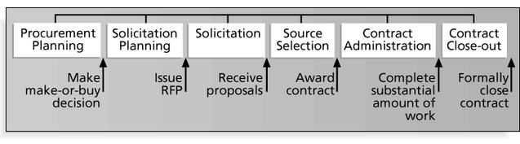
Project Procurement Management Processes and Key Outputs

Slide 8
Procurement Planning
Procurement planning involves identifying which project needs can be best met by using products or services outside the organization. It includes deciding
  whether to procure
  how to procure
  what to procure
  how much to procure
  when to procure

Slide 9
Collaborative Procurement
Several organizations, even competitors, have found that it makes sense to collaborate on procurement for some projects

Slide 10
Procurement Planning Tools and Techniques
Make-or-buy analysis: determining whether a particular product or service should be made or performed inside the organization or purchased from someone else. Often involves financial analysis
Experts, both internal and external, can provide valuable inputs in procurement decisions

Slide 11
Make-or Buy Example
Assume you can lease an item you need for a project for $150/day. To purchase the item, the investment cost is $1,000, and the daily cost would be another $50/day.
How long will it take for the lease cost to be the same as the purchase cost?
If you need the item for 12 days, should you lease it or purchase it?

Slide 12
Make-or Buy Solution
Set up an equation so the “make” is equal to the “buy”
In this example, use the following equation. Let d be the number of days to use the item.
  $150d = $1,000 + $50d
Solve for d as follows:
  Subtract $50d from the right side of the equation to get
  $100d = $1,000
  Divide both sides of the equation by $100
  d = 10 days
The lease cost is the same as the purchase cost at 10 days
If you need the item for 12 days, it would be more economical to purchase it

Slide 13
Types of Contracts
Fixed price or lump sum: involve a fixed total price for a well-defined product or service
Cost reimbursable: involve payment to the seller for direct and indirect costs
Time and material contracts: hybrid of both fixed price and cost reimbursable, often used by consultants
Unit price contracts: require the buyer to pay the seller a predetermined amount per unit of service

Slide 14
Cost Reimbursable Contracts
Cost plus incentive fee (CPIF): the buyer pays the seller for allowable performance costs plus a predetermined fee and an incentive bonus
Cost plus fixed fee (CPFF): the buyer pays the seller for allowable performance costs plus a fixed fee payment usually based on a percentage of estimated costs
Cost plus percentage of costs (CPPC): the buyer pays the seller for allowable performance costs plus a predetermined percentage based on total costs

Slide 15
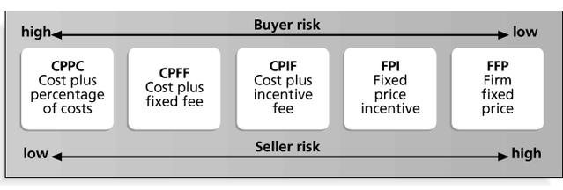
Contract Types Versus Risk

Slide 16
Statement of Work (SOW)
A statement of work is a description of the work required for the procurement
Many contracts, mutually binding agreements, include SOWs
A good SOW gives bidders a better understanding of the buyer’s expectations

Slide 17
Statement of Work (SOW) Template

Slide 18
Solicitation Planning
Solicitation planning involves preparing several documents:
  Request for Proposals: used to solicit proposals from prospective sellers where there are several ways to meet the sellers’ needs
  Requests for Quotes: used to solicit quotes for well-defined procurements
  Invitations for bid or negotiation and initial contractor responses are also part of solicitation planning

Slide 19
Outline for a Request for Proposal (RFP)

Slide 20
Solicitation
Solicitation involves obtaining proposals or bids from prospective sellers
Organizations can advertise to procure goods and services in several ways
  approaching the preferred vendor
  approaching several potential vendors
  advertising to anyone interested
A bidders’ conference can help clarify the buyer’s expectations

Slide 21
Source Selection
Source selection involves
  evaluating bidders’ proposals
  choosing the best one
  negotiating the contract
  awarding the contract
It is helpful to prepare formal evaluation procedures for selecting vendors
Buyers often create a “short list”

Slide 22
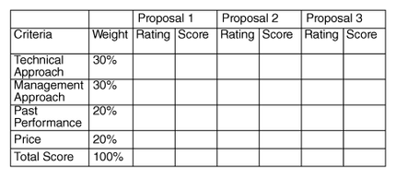
Figure 11-5. Sample Proposal Evaluation Sheet

Slide 23
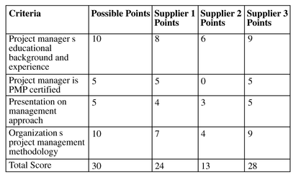
Figure 11-6. Detailed Criteria for Selecting Suppliers

Slide 24
Be Careful in Selecting Suppliers and Writing Their Contracts
Many dot-com companies were created to meet potential market needs, but many went out of business, mainly due to poor business planning, lack of senior management operations experience, lack of leadership, and lack of visions. Check the stability of suppliers
Even well-known suppliers can impede project success. Be sure to write and manage contracts well with all suppliers (see What Went Wrong?)

Slide 25
Contract Administration
Contract administration ensures that the seller’s performance meets contractual requirements
Contracts are legal relationships, so it is important that legal and contracting professionals be involved in writing and administering contracts
Many project managers ignore contractual issues, which can result in serious problems

Slide 26
Suggestions on Change Control for Contracts
Changes to any part of the project need to be reviewed, approved, and documented by the same people in the same way that the original part of the plan was approved
Evaluation of any change should include an impact analysis. How will the change affect the scope, time, cost, and quality of the goods or services being provided?
Changes must be documented in writing. Project team members should also document all important meetings and telephone phone calls

Slide 27
Contract Close-out
Contract close-out includes
  product verification to determine if all work was completed correctly and satisfactorily
  administrative activities to update records to reflect final results
  archiving information for future use
Procurement audits identify lessons learned in the procurement process

Slide 28
Using Software to Assist in Project Procurement Management
Word processing software helps in writing proposals and contracts, spreadsheets help in evaluating suppliers, databases help track suppliers, and presentation software aids in presenting procurement-related information
In the late 1990s and early 2000s, many companies started using e-procurement software to do many procurement functions electronically
Companies such as Commerce One, Ariba, Concur Technologies, SAS, and Baan provide corporate procurement services over the Internet
Organizations also use other Internet tools to help find information on suppliers or auction goods and services

Slide 29
References
“Information Technology Project Management”, Kathy Schwalbe, sixth Edition, THOMSON Course Technology

